Slide 1
Analysis of
sector performance during recessions Performance analysis of 11 sectors in S&P 500 during 3 crashes
Ash Tao, Chris Burley, Maica Tran and Sabrina Tsan

Slide 2
Content
Who needs the analysis?
What questions can solve the problem?
Exploratory data analysis(EDA)
Questions have been answered
What are the limitations?
How can the analysis be improved?

Slide 3
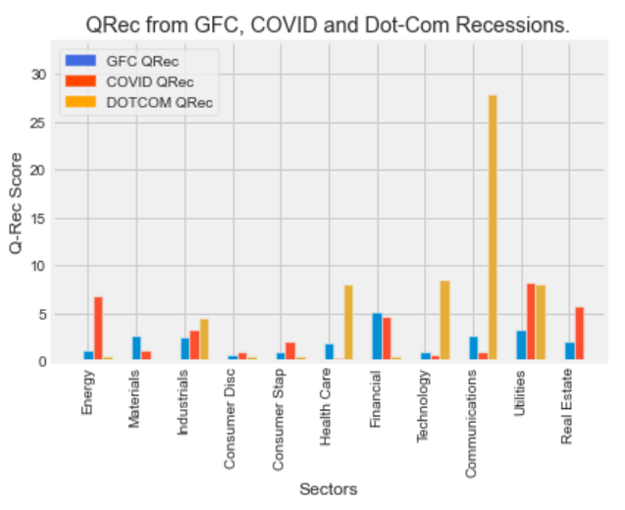
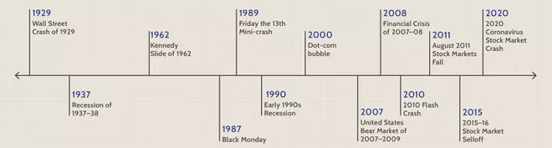
Who needs the analysis Key Stakeholders: investors & traders in the US Market
Investors
Traders
Analysis
4 crashes we chose to analyze:
COVID-19: 2 months
Global Financial Crisis(GFC): 18 months
Dot-Com bubble: 8 months
Notes:
llllllllllll

Slide 4
What questions can solve the problem?
How long does it take the market and its eleven sectors to recover after a recession?
Do all sectors take the same amount of time to recover after a recession?
Is there a link between the number of days a recession lasts for and the number of days it takes for the market to recover?

Slide 5
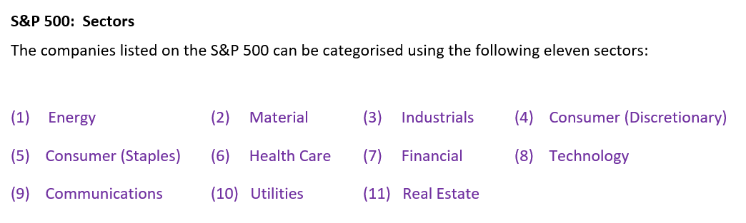
QRec
The Recovery Quotient:
Our group was interested in comparing the recovery times of sectors across DIFFERENT recessions.
RECESSIONS : COVID-19 GLOBAL FINANCIAL CRISIS DOT-COM (and September 11 attack)

Slide 6


The Recovery Quotient:
Using ‘days’ to measure recovery works WELL when comparing sector performance after the SAME recession.
Using ‘days’ to measure recovery after DIFFERENT recessions seemed, to our group, to lack meaning.
Using ‘days’ to measure recovery works WELL when comparing sector performance after the SAME recession.
To facilitate cross-recession comparison we created the Recovery Quotient (QRec).

Slide 7
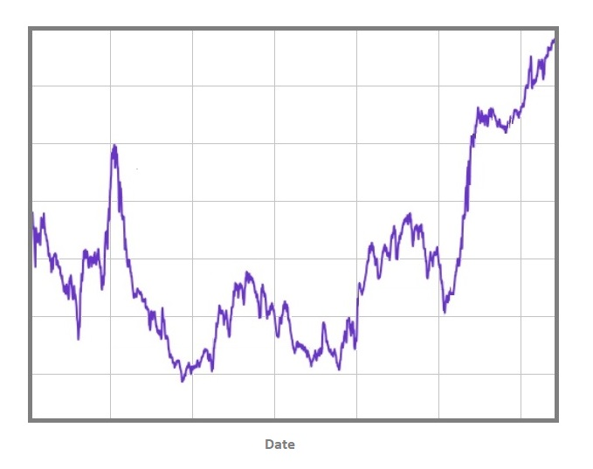

Slide 8
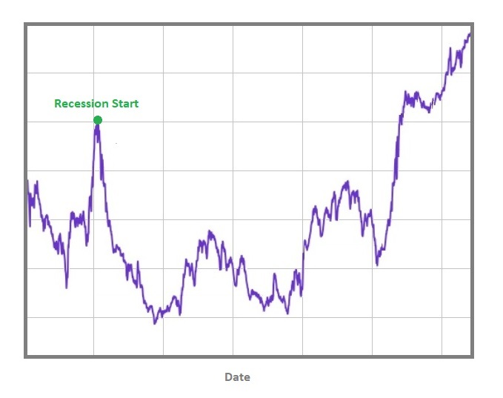

Slide 9
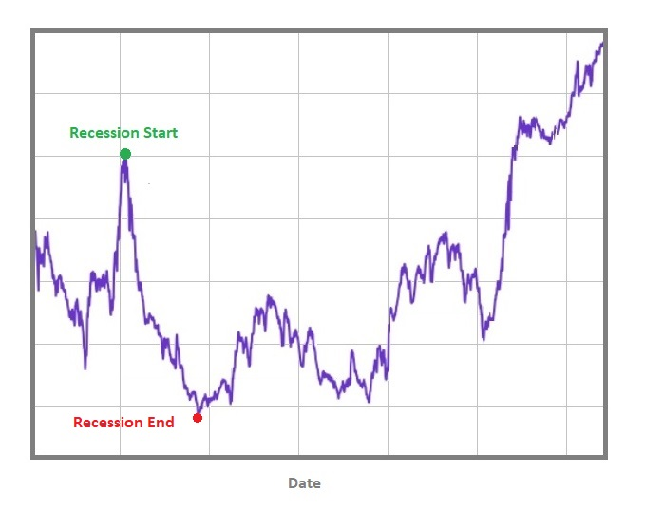

Slide 10
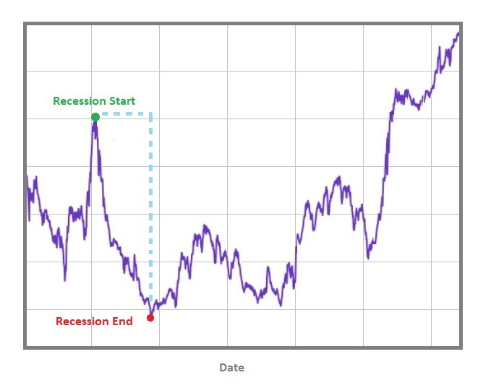

Slide 11
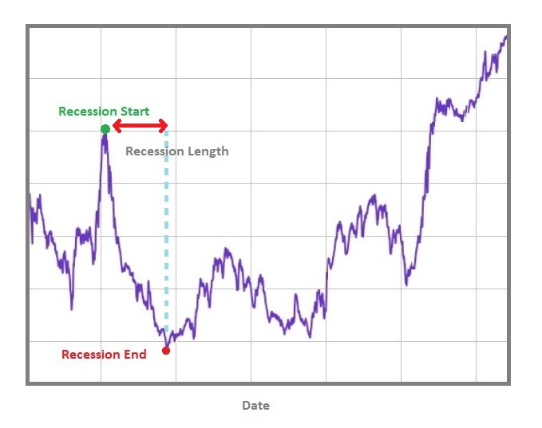

Slide 13
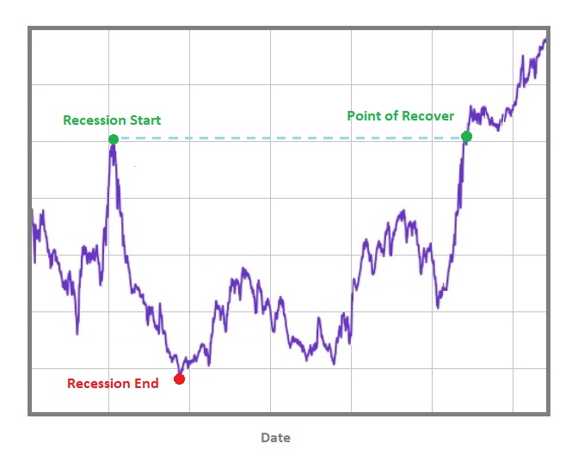

Slide 14
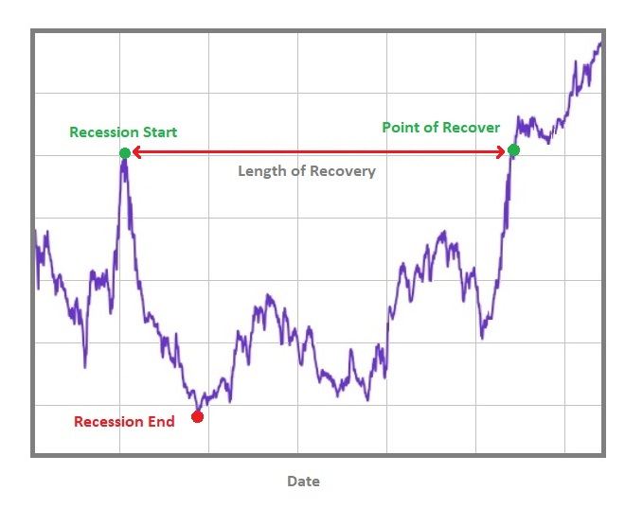

Slide 15

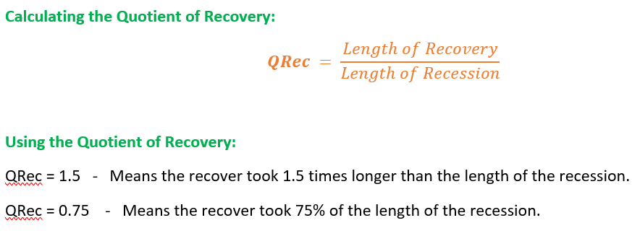
The Recovery Quotient:

Slide 16

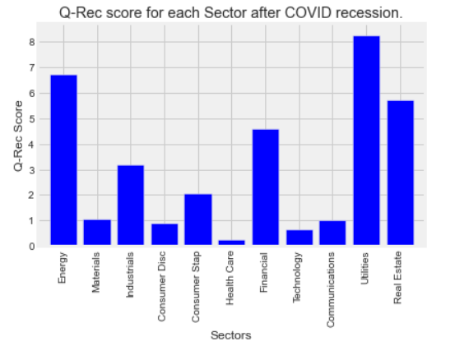
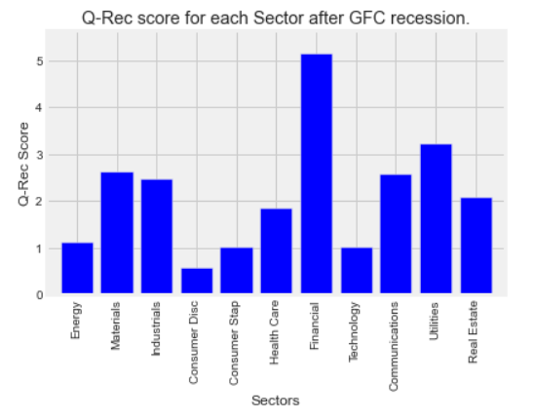
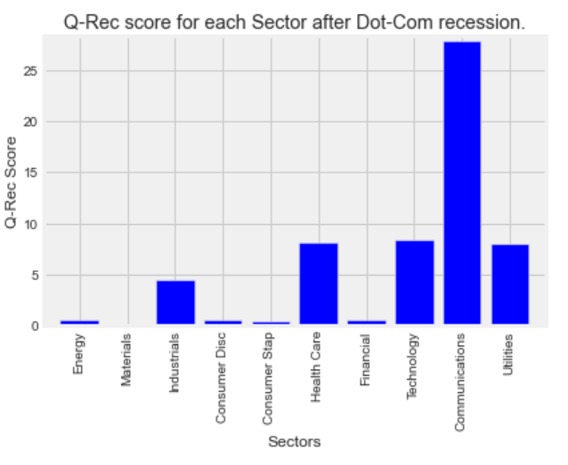
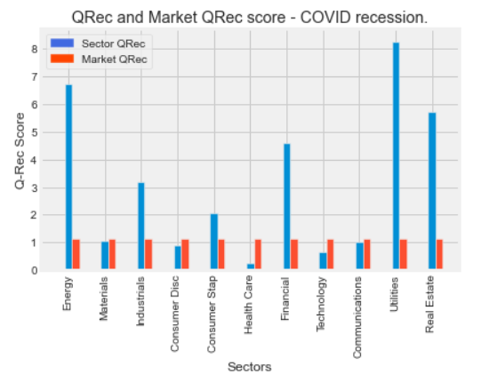
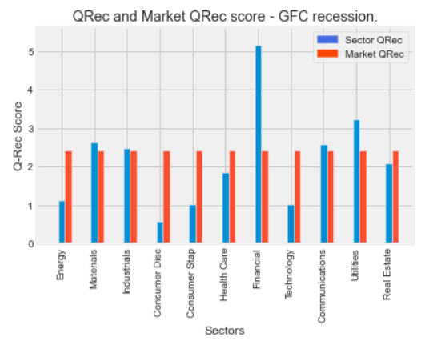
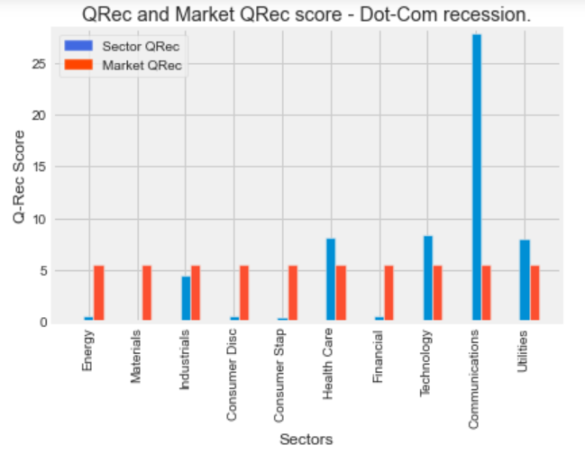
Key Question 1:
Do all sectors take the same amount of time to recover after a recession?

Slide 17
Key Question 2:
Is there a strong link between the number of days a recession lasts for and the number of days it takes for the market and its eleven sectors to recover?
The COVID-19 recession lasted 61 days and took the market 68 days to recover (QRec = 1.11).
The Dot-Com recession lasted 246 days and took the market 1365 days to recover (QRec = 5.54)
The GFC recession lasted a staggering 549 days……
If there was a link what would you predict?
The GFC only required a recovery time of 1327 days (QRec = 2.417).

Slide 18
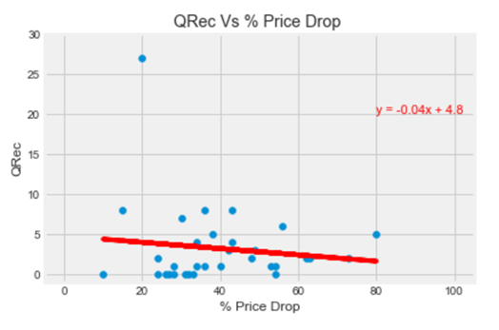
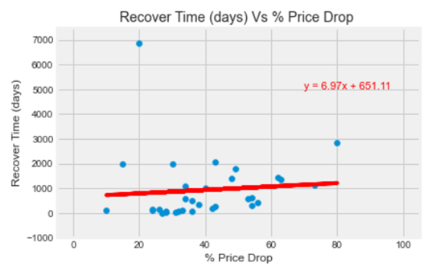
Key Question 3:
Do sectors that experience higher percentage losses during a recession take longer to recover?
r-squared value of 0.007.
r-squared value of 0.016

Slide 19
Limitations
Limited API data:
We could not source pre 2000s data from the Yahoo finance API.
This precluded us from analysing more recessions.
Real Estate sector data did not exist at the time of the Dot-Com recession. This gave us incomplete data for that recession.
Time:
The group would have analysed this data in even greater detail had time not run out.

Slide 20
Key insights (Chris)
During each of the last three recessions, there is an enormous amount of variation sector recovery times. Sectors recover at different rates to one another.
One might think that a longer recession would mean a longer recovery for both the market and its eleven sectors, but this has not been the case for the last three recessions.
According to data from the last 3 recessions there is no relationship between the loss in value incurred by a sector and the time it takes to recover.

Slide 23
What questions can solve the problem?
How the GDP during recession?
Is there any correlation between recessions?
Is there any link between GDP and stock market?

Slide 26
What questions can solve the problem?
Can we predict the price on different sectors?
Is there a correlation between sectors?

Slide 27
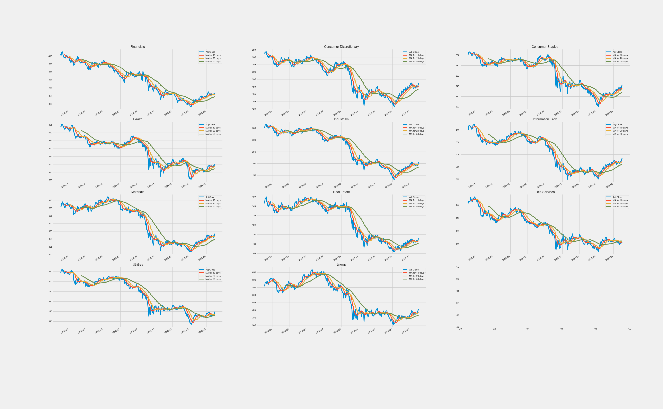
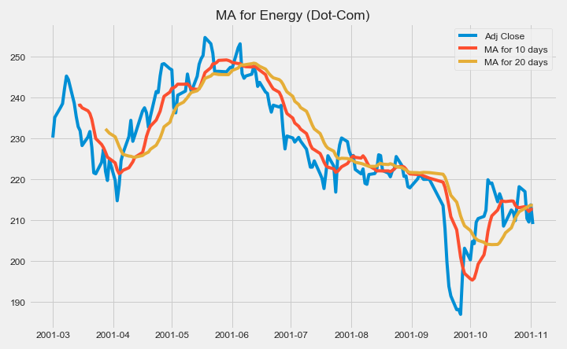
Questions have been answered
1st question: Can the previous price help to make a judgment on sector performance?
The moving averages can help to identify trend direction and to determine support and resistance levels.
We can judge the by the crossover on the closing price and the moving average line. When the price crosses above or below a moving average, there will be a signal for the potential change in trend.
We can judge by the crossover on the short-term and long-term moving average line. When the shorter-term MA crosses above the longer-term MA, it's a buy signal, as it indicates that the trend is shifting up. Meanwhile, when the shorter-term MA crosses below the longer-term MA, it's a sell signal, as it indicates that the trend is going down.
Notes:
If prices start to fluctuate will generate multiple trend reversals or trade signals. And sometimes the market won't respect MA support/resistance trade signals. We will need another indicator to help clarify the trend. Moving averages work well in strong trending conditions but poorly in choppy or ranging conditions.

Slide 28
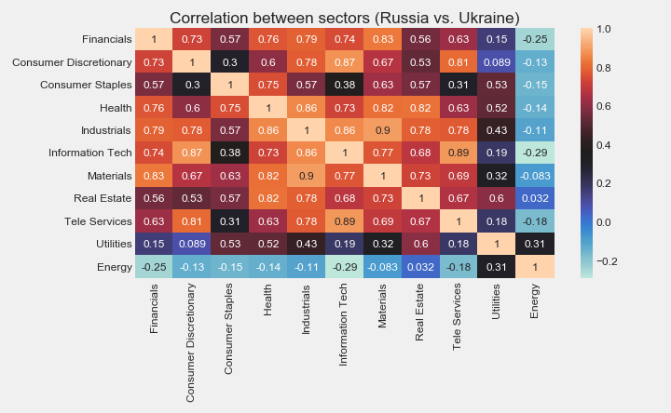
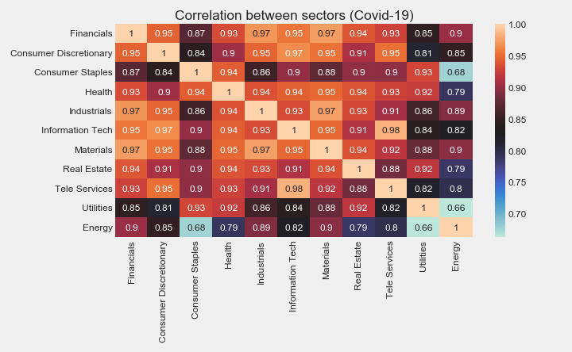
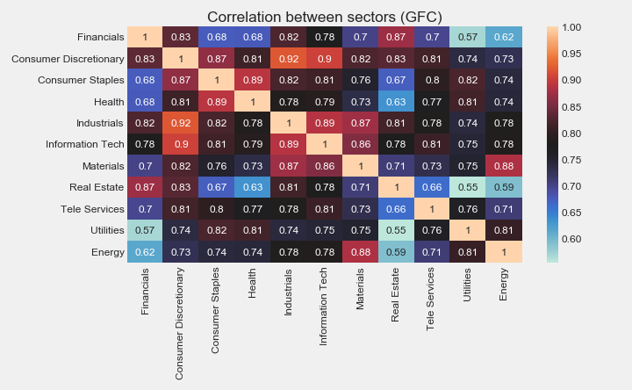
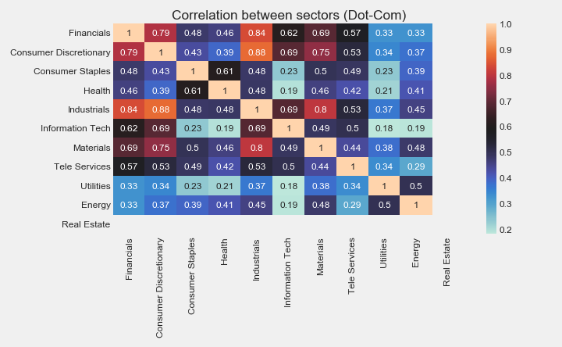
Questions have been answered
2nd question: Is there a correlation between the sectors?
Yes, based on the heat map related to the daily return.
The correlations are getting tighter over time.
Therefore, during the crash, no matter which sector you invest in, it will be influenced by other sectors. It is not easy to say whether there is a specific sector that is independent from the others.

Slide 29
What questions can solve the problem?
Has the market recovered after the Covid 19 recession?
Is the market on a bull or bear trend?
Is it still a good time to invest in the stock market?

Slide 32
Exploratory Data Analysis (EDA)
Key Insights:
We can tell a price trend based on previous price.
The

Slide 33
What Limitations
The dataset is not completed.
If we can break down the selected sample, analyse individual stocks instead of the 11 sectors. If we can expand the size of the project, perform data analysis in a larger dataset, such as studying the top 20 stocks in each sector. The results may be more convincing.
3 selected crash periods have different causes.
The cause of crash is an important dimension to study a crash. The impact of “Black Swans” and “Grey Rhinos” on the market is very different. In this study, the crash we selected includes both the predictable crash with a high possibility and the unpredictable crash with a low possibility.
If we can select crashes with more similar causes for research, the conclusions obtained may be more helpful for relevant personnel to obtain the judgments they need

Slide 34
Q & A

